Slide 1
Microsoft Teams User Group Berlin
4. Februar 2021

Slide 2
Danke!

Slide 3
Agenda
18:00 - 18:15 | Landing Zone
18:15 - 19:15 | Talk 1 - Microsoft Teams Lifecycle Management with Power Suite Michael Plettner (@plemich)
19:15 - 19:30 | Pause
19:30 - 19:50 | Thomas Stensitzki Microsoft Teams Neuigkeiten
20:00 - 20:45 | Talk 2 - Microsoft Teams und Data Loss Prevention Torben Ritter (@TobiRitter)
20:45 - ? | Fragen und Antworten rund um Teams Organisatorisches
Dieses Meeting wird aufgezeichnet und im Community Tenant Team für User Group Mitglieder bereitgestellt. This meeting will be recorded and published in the User Group Community Tenant.

Slide 4
Microsoft Teams Lifecycle Management with Power Suite
Michael Plettner @plemich

Slide 5
Pause ☺
→ Gleich geht es weiter (19:30)

Slide 6
Agenda
18:00 - 18:15 | Landing Zone
18:15 - 19:15 | Talk 1 - Microsoft Teams Lifecycle Management with Power Suite Michael Plettner (@plemich)
19:15 - 19:30 | Pause
19:30 - 19:50 | Thomas Stensitzki Microsoft Teams Neuigkeiten
20:00 - 20:45 | Talk 2 - Microsoft Teams und Data Loss Prevention Torben Ritter (@TobiRitter)
20:45 - ? | Fragen und Antworten rund um Teams Organisatorisches
Dieses Meeting wird aufgezeichnet und im Community Tenant Team für User Group Mitglieder bereitgestellt. This meeting will be recorded and published in the User Group Community Tenant.

Slide 7
Was ist neu in Teams Ankündigungen & Rollouts
Thomas Stensitzki

Slide 8
Microsoft 365 Admin Center
Update im Nachrichtencenter

Slide 9
Was ist neu in Teams
Introducing an enhanced Teams Calling experience (→ Februar)
Microsoft Teams: Touch Bar Meetings Controls for Mac (→ Februar)
Large gallery view and Together Mode for web meetings in Edge and Chrome browsers (Januar)
Meeting Reactions in Teams Meetings (→ Februar)
New meeting options for managing large Teams meetings in Outlook for Windows (→März)
Microsoft Teams will queue sent messages when offline (Februar)
Notes:
https://www.microsoft.com/microsoft-365/roadmap?ms.url=m365comroadmap&rtc=1&filters=&searchterms=65946
https://www.microsoft.com/microsoft-365/roadmap?ms.url=m365comroadmap&rtc=1&filters=&searchterms=68905

Slide 10
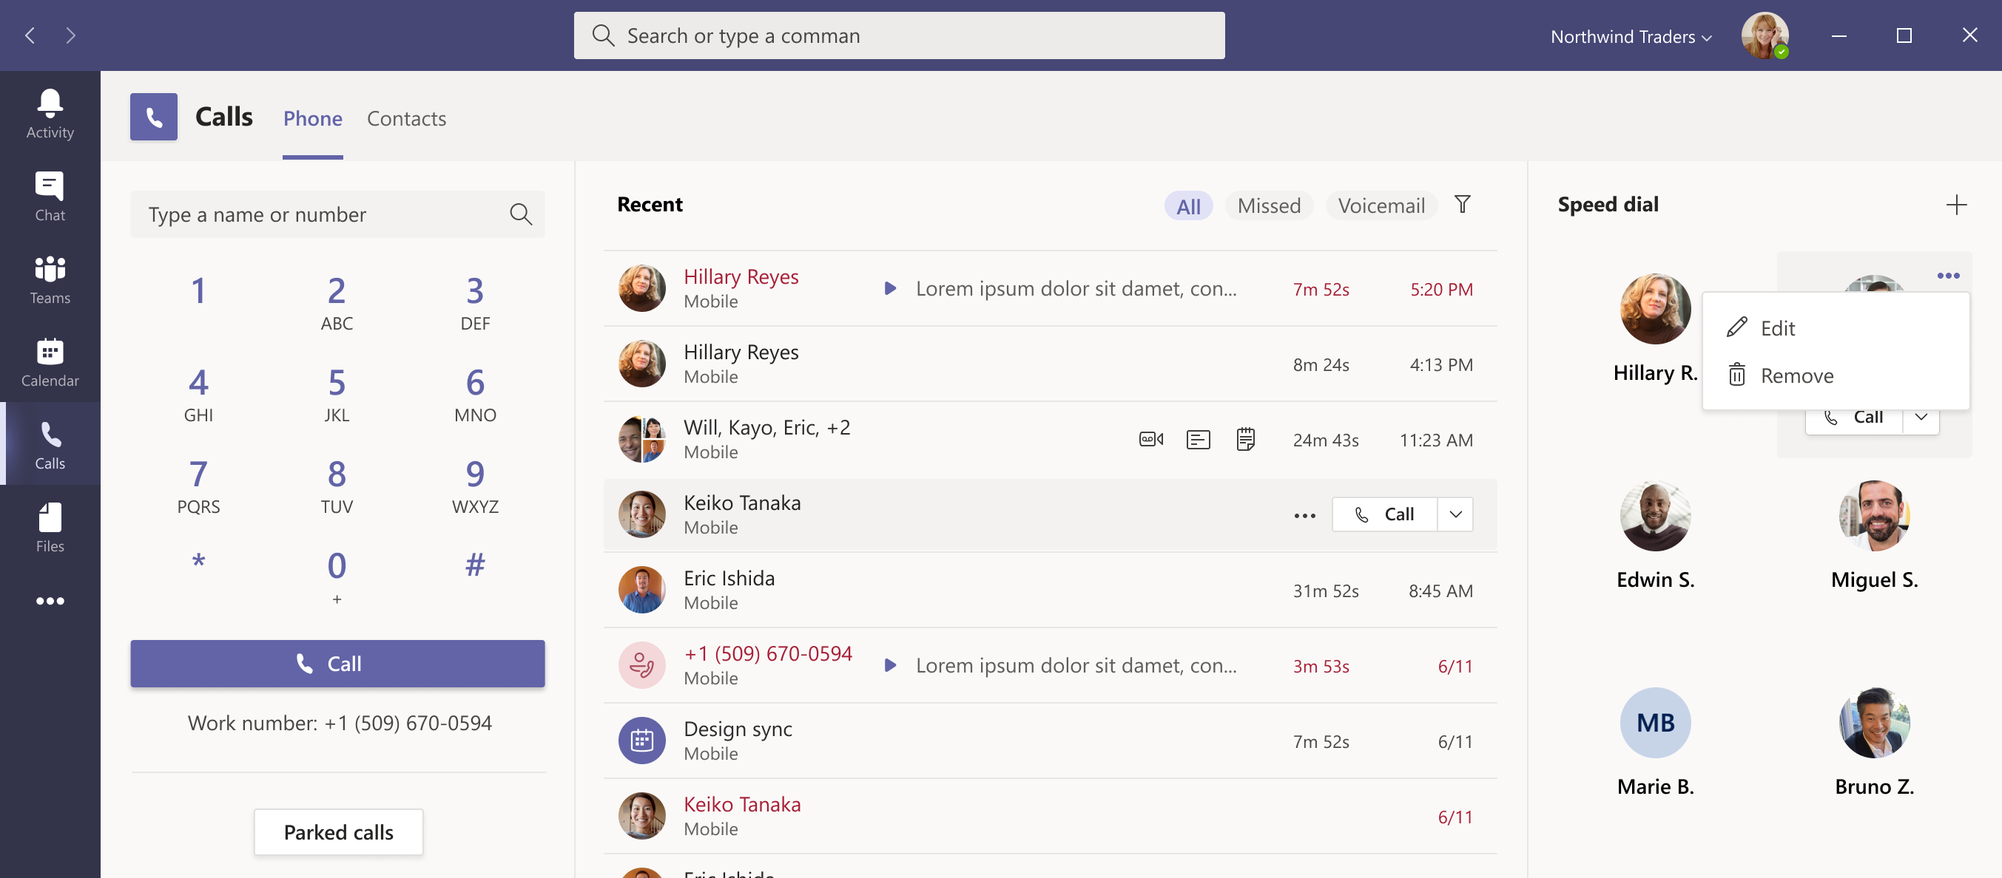
Introducing an enhanced Teams Calling experience
Notes:
https://www.microsoft.com/microsoft-365/roadmap?rtc=1%26filters=&searchterms=68771

Slide 11
Was ist neu in Teams
Introducing an enhanced Teams Calling experience (→ Februar)
Microsoft Teams: Touch Bar Meetings Controls for Mac (→ Februar)
Large gallery view and Together Mode for web meetings in Edge and Chrome browsers (Januar)
Meeting Reactions in Teams Meetings (→ Februar)
New meeting options for managing large Teams meetings in Outlook for Windows (→März)
Microsoft Teams will queue sent messages when offline (Februar)
Notes:
https://www.microsoft.com/microsoft-365/roadmap?ms.url=m365comroadmap&rtc=1&filters=&searchterms=65946
https://www.microsoft.com/microsoft-365/roadmap?ms.url=m365comroadmap&rtc=1&filters=&searchterms=68905

Slide 12
Was ist neu in Teams
Introducing an enhanced Teams Calling experience (→ Februar)
Microsoft Teams: Touch Bar Meetings Controls for Mac (→ Februar)
Large gallery view and Together Mode for web meetings in Edge and Chrome browsers (Januar)
Meeting Reactions in Teams Meetings (→ Februar)
New meeting options for managing large Teams meetings in Outlook for Windows (→März)
Microsoft Teams will queue sent messages when offline (Februar)
Notes:
https://www.microsoft.com/microsoft-365/roadmap?ms.url=m365comroadmap&rtc=1&filters=&searchterms=65946
https://www.microsoft.com/microsoft-365/roadmap?ms.url=m365comroadmap&rtc=1&filters=&searchterms=68905

Slide 13
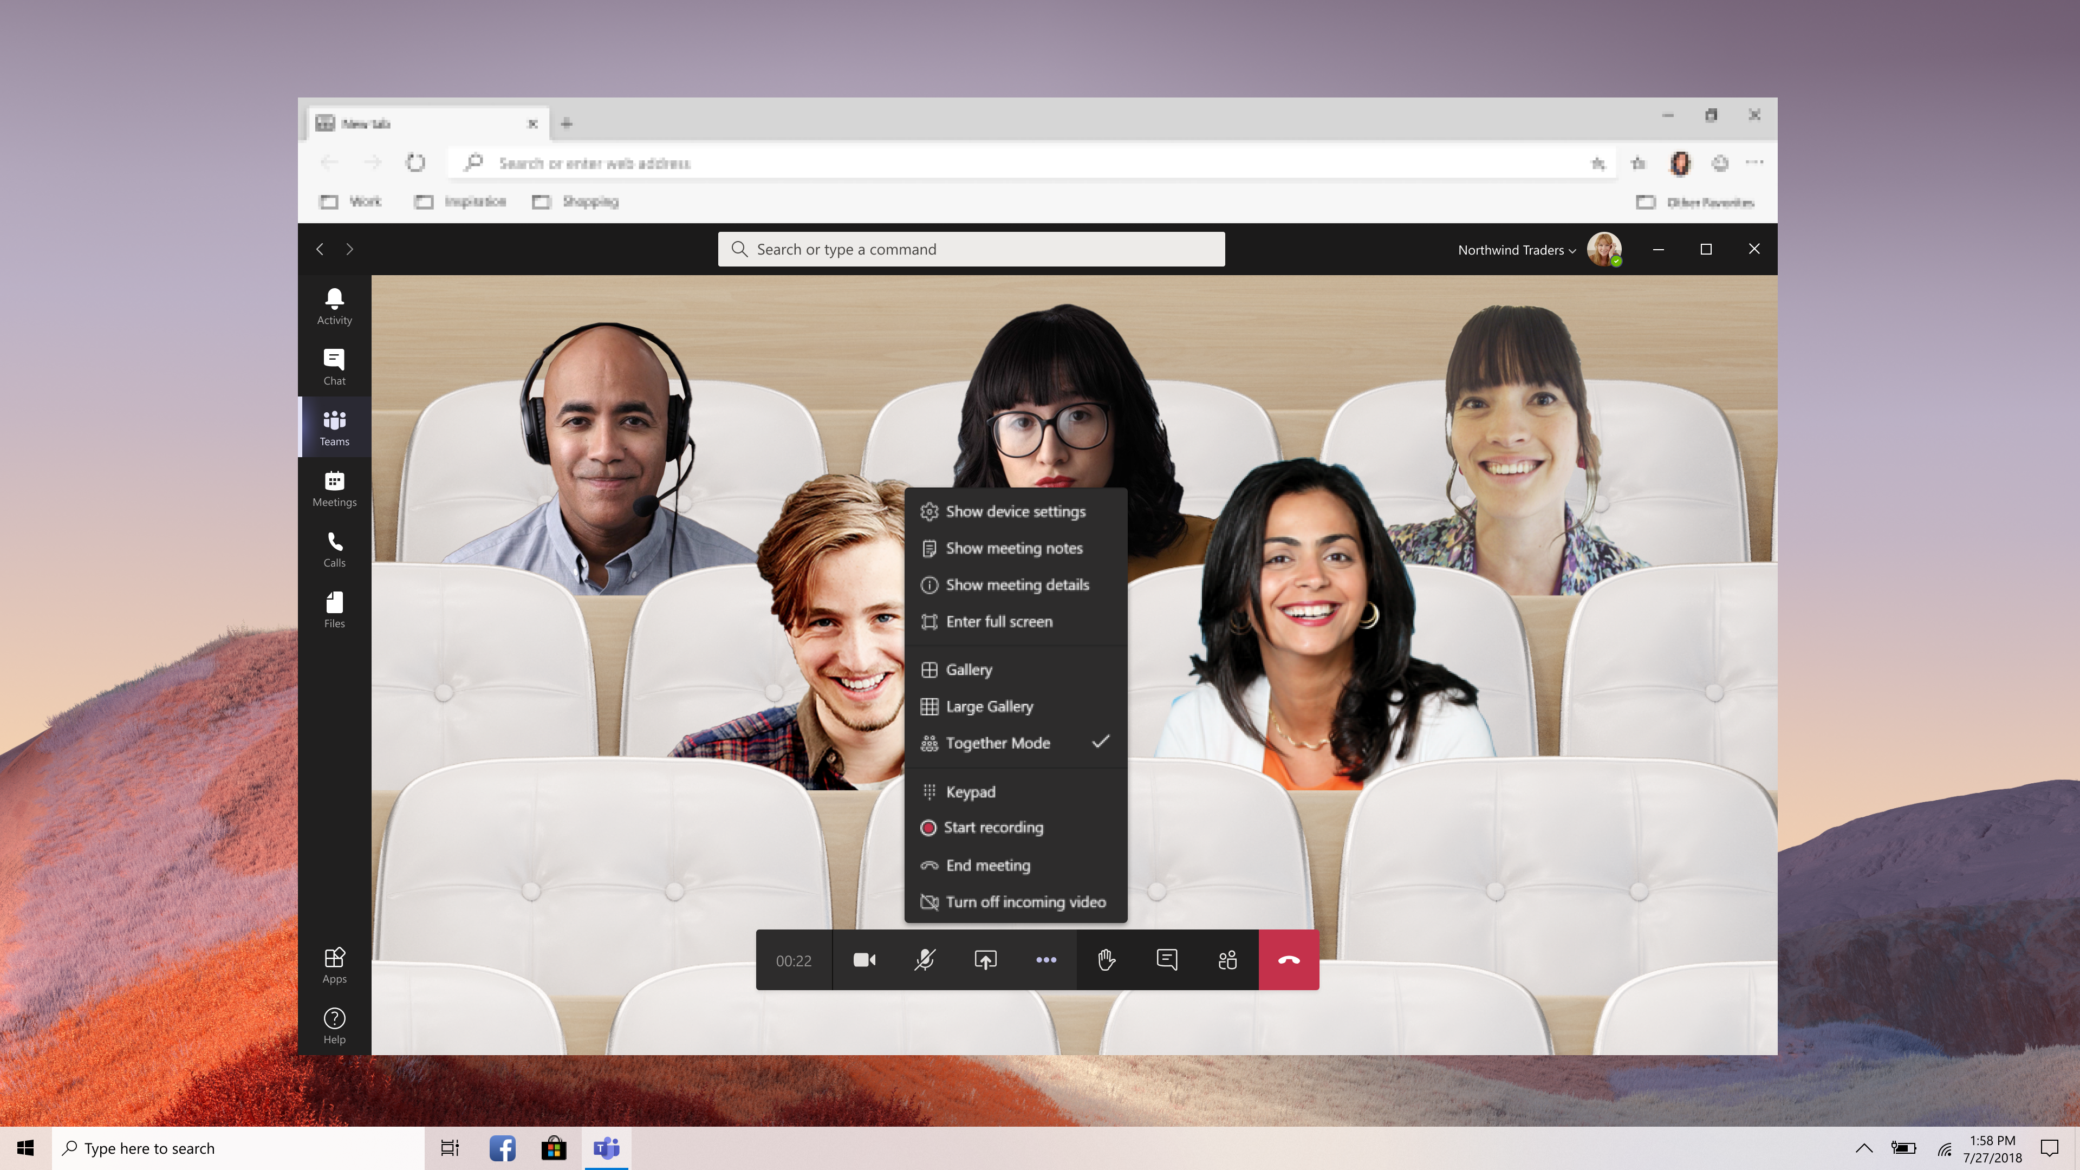
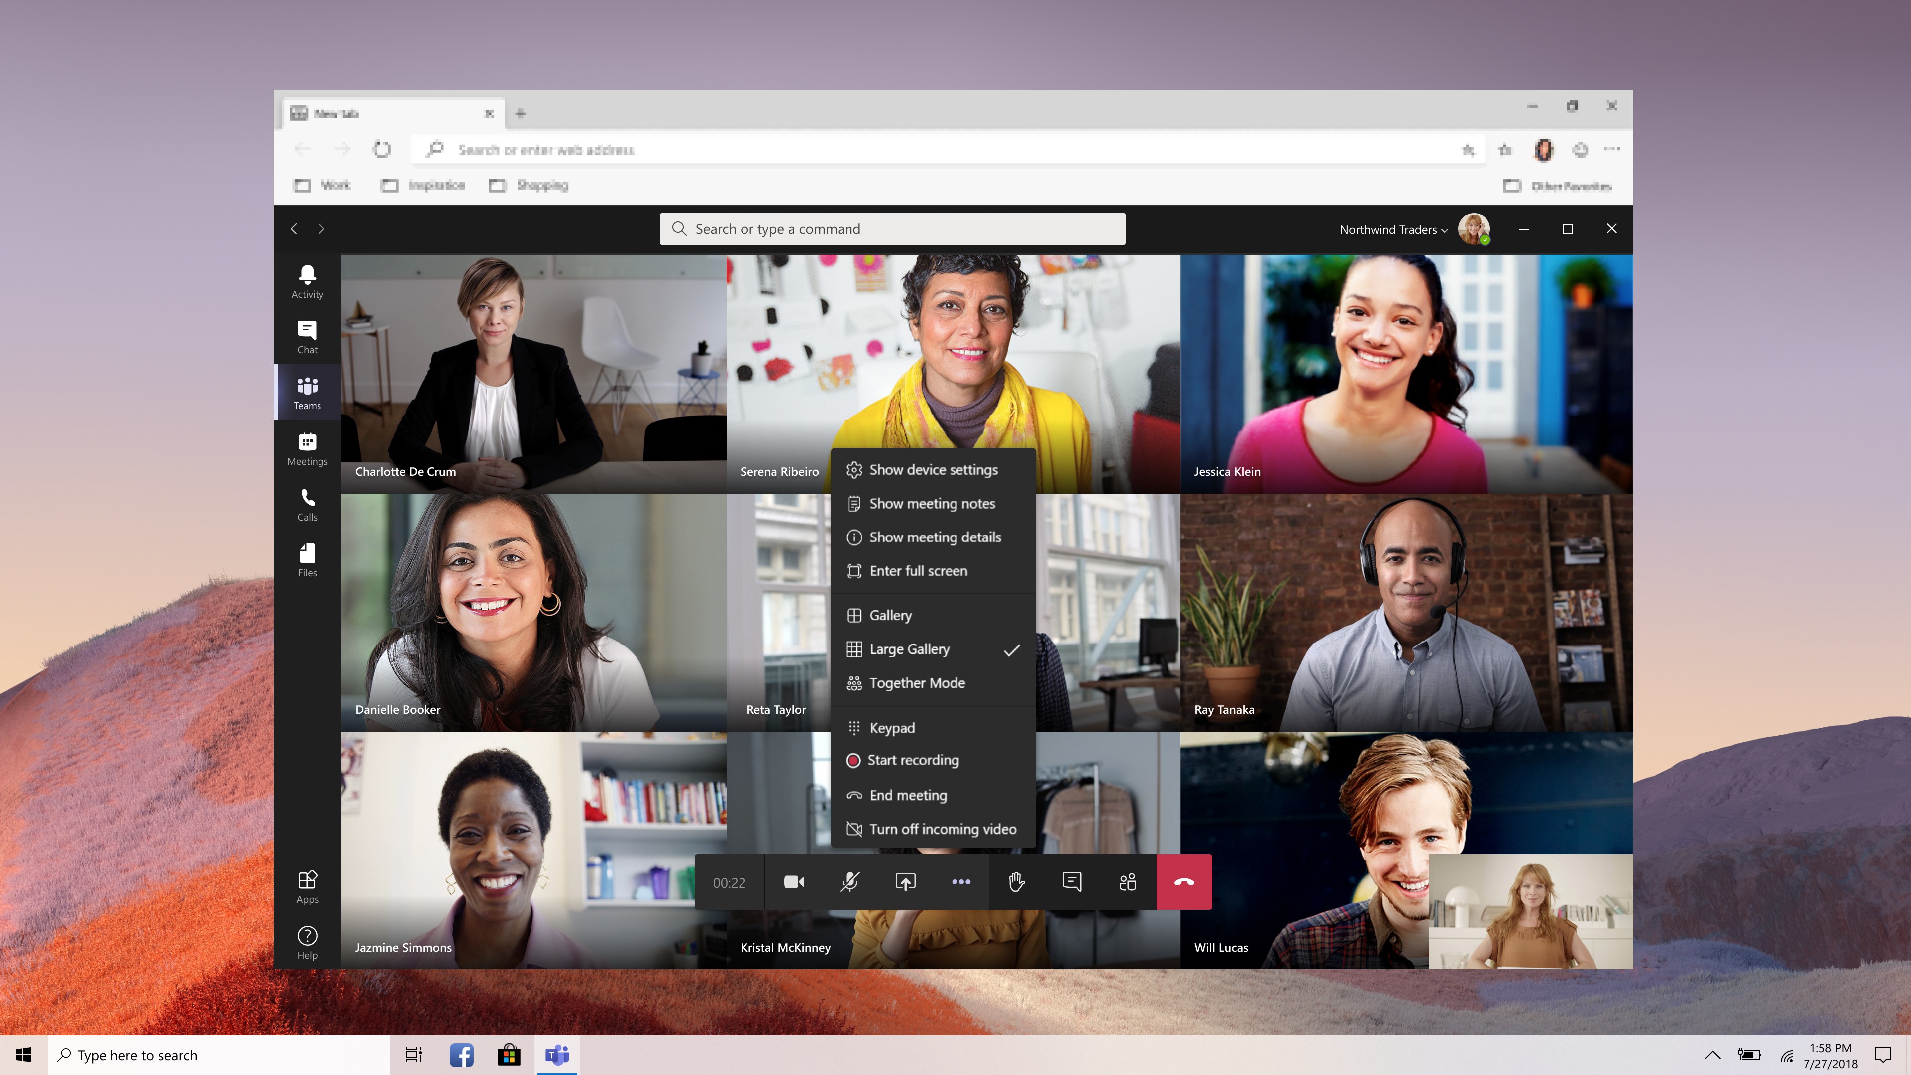
Large gallery view and Together Mode for web meetings in Edge and Chrome browsers
Notes:
https://www.microsoft.com/microsoft-365/roadmap?filters=&searchterms=70573
This release will improve the experience for users who join Teams meetings in Edge and Chrome browsers by positioning up to 50 invitees into a virtual space by removing each individual background people have and replacing them with a common background.

Slide 14
Was ist neu in Teams
Introducing an enhanced Teams Calling experience (→ Februar)
Microsoft Teams: Touch Bar Meetings Controls for Mac (→ Februar)
Large gallery view and Together Mode for web meetings in Edge and Chrome browsers (Januar)
Meeting Reactions in Teams Meetings (→ Februar)
New meeting options for managing large Teams meetings in Outlook for Windows (→März)
Microsoft Teams will queue sent messages when offline (Februar)
Notes:
https://www.microsoft.com/microsoft-365/roadmap?ms.url=m365comroadmap&rtc=1&filters=&searchterms=65946
https://www.microsoft.com/microsoft-365/roadmap?ms.url=m365comroadmap&rtc=1&filters=&searchterms=68905

Slide 15
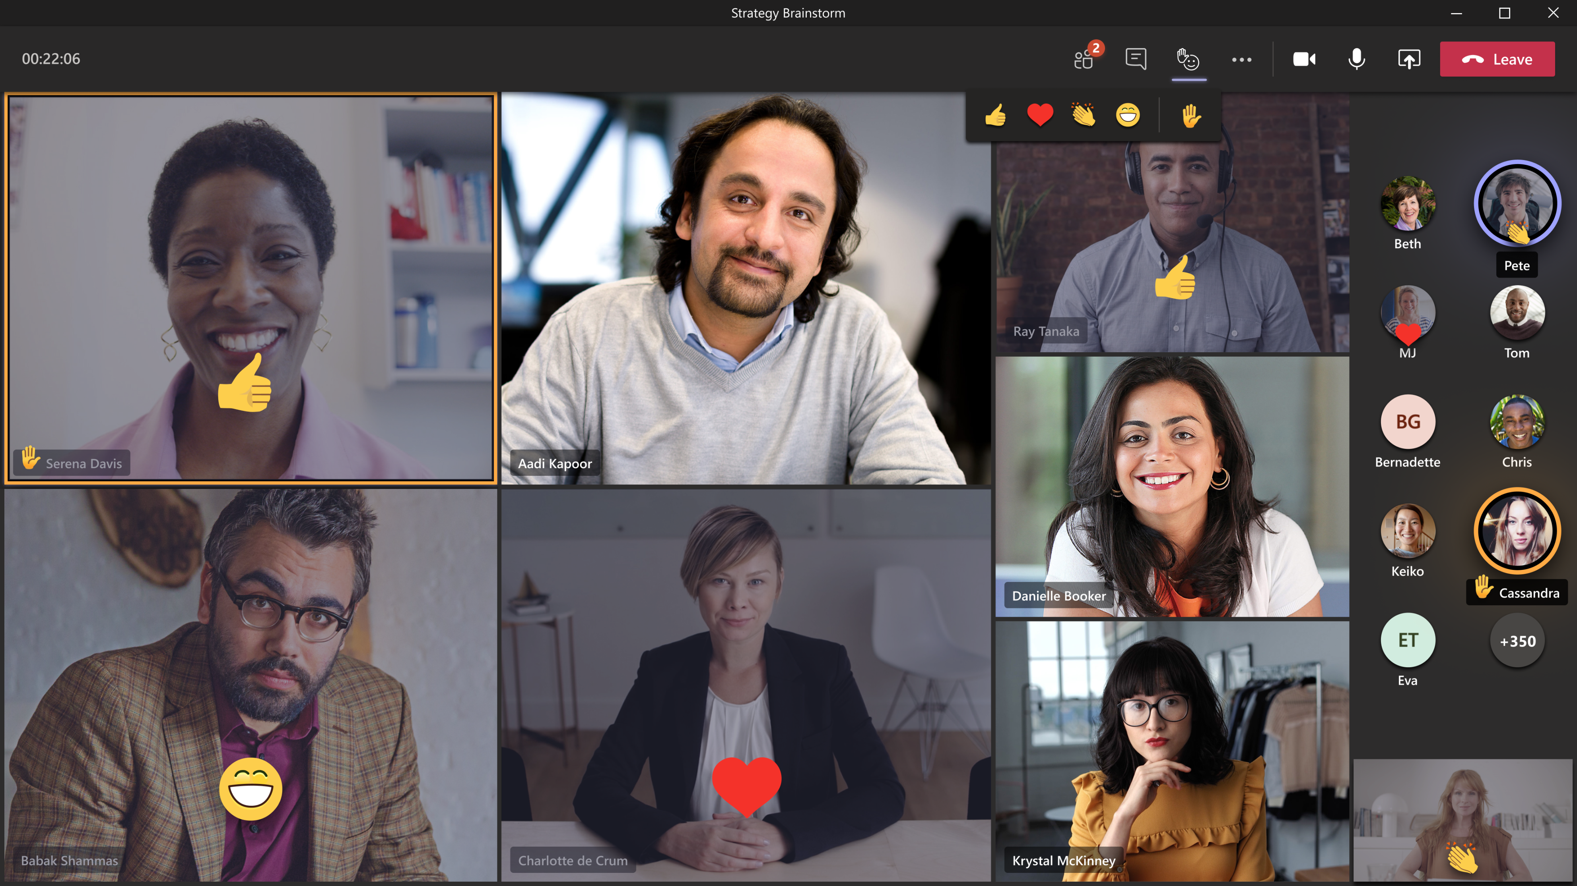
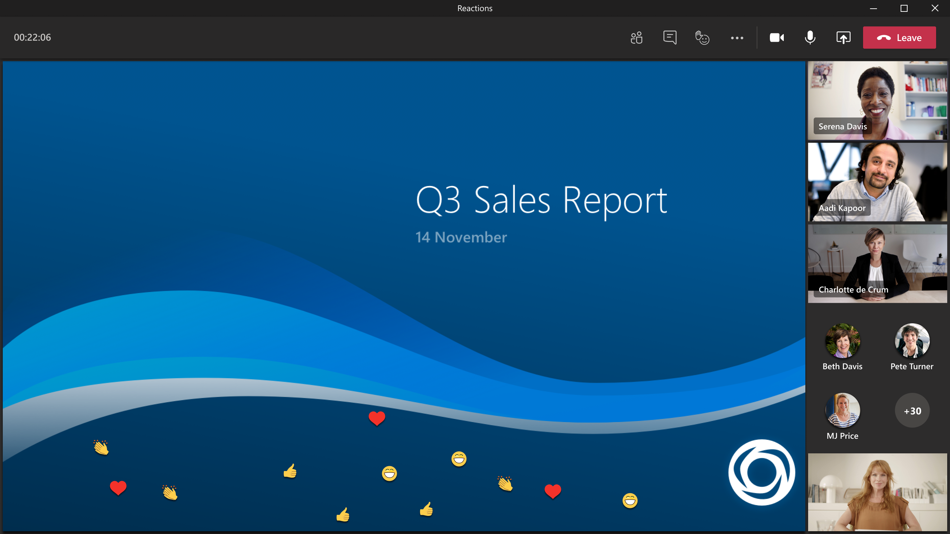
Meeting Reactions in Teams Meetings
Notes:
https://www.microsoft.com/microsoft-365/roadmap?ms.url=m365comroadmap&rtc=1&filters=&searchterms=65946
https://www.microsoft.com/microsoft-365/roadmap?ms.url=m365comroadmap&rtc=1&filters=&searchterms=68905
AllowMeetingReactions Policy

Slide 16
Was ist neu in Teams
Introducing an enhanced Teams Calling experience (→ Februar)
Microsoft Teams: Touch Bar Meetings Controls for Mac (→ Februar)
Large gallery view and Together Mode for web meetings in Edge and Chrome browsers (Januar)
Meeting Reactions in Teams Meetings (→ Februar)
New meeting options for managing large Teams meetings in Outlook for Windows (→März)
Microsoft Teams will queue sent messages when offline (Februar)

Slide 17
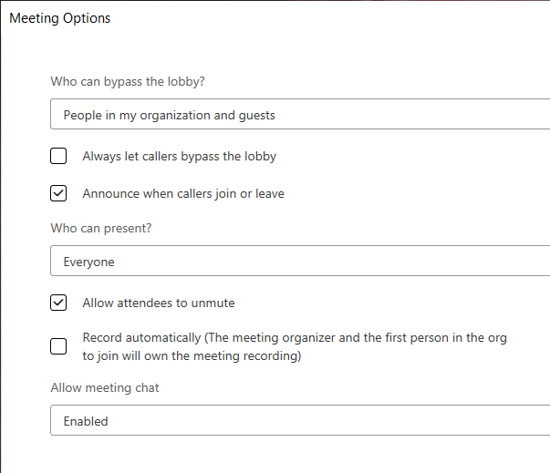
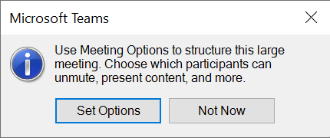
New meeting options for managing large Teams meetings in Outlook for Windows
Notes:
https://www.microsoft.com/microsoft-365/roadmap?rtc=1%26filters=&searchterms=68918

Slide 18
Was ist neu in Teams
Introducing an enhanced Teams Calling experience (→ Februar)
Microsoft Teams: Touch Bar Meetings Controls for Mac (→ Februar)
Large gallery view and Together Mode for web meetings in Edge and Chrome browsers (Januar)
Meeting Reactions in Teams Meetings (→ Februar)
New meeting options for managing large Teams meetings in Outlook for Windows (→März)
Microsoft Teams will queue sent messages when offline (Februar)

Slide 19
Was ist neu in Teams
Option to create all meetings online in Outlook for Windows (Januar)
Profile menu update, relocating profile menu links to a new menu in the title bar (Januar)
Revised In-meeting Share Experience (März)
Teams desktop app for Mac: Include computer sound in a meeting (Februar)
Change in display of hierarchical sensitivity labels (März)
Introducing history menu in Microsoft Teams (Februar)
Use an iPad to present in a live event (→ Februar)

Slide 20
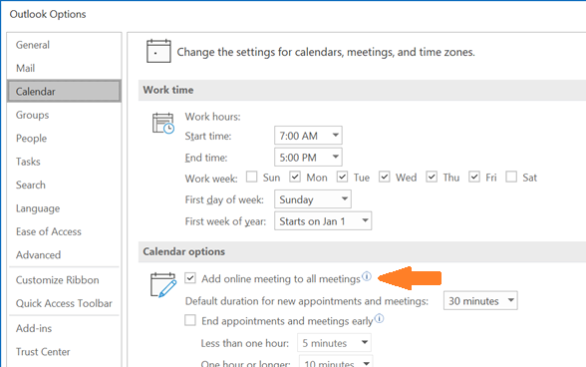
Option to create all meetings online in Outlook for Windows
Notes:
https://www.microsoft.com/microsoft-365/roadmap?filters=&searchterms=66021
This feature will be available with the Teams update rolling out mid-to late-January and the January 2021 Monthly Channel (Standard) update of Outlook for Windows.
Set-OrganizationConfig -OnlineMeetingsByDefaultEnabled $True

Slide 21
Was ist neu in Teams
Option to create all meetings online in Outlook for Windows (Januar)
Profile menu update, relocating profile menu links to a new menu in the title bar (Januar)
Revised In-meeting Share Experience (März)
Teams desktop app for Mac: Include computer sound in a meeting (Februar)
Change in display of hierarchical sensitivity labels (März)
Introducing history menu in Microsoft Teams (Februar)
Use an iPad to present in a live event (→ Februar)

Slide 22
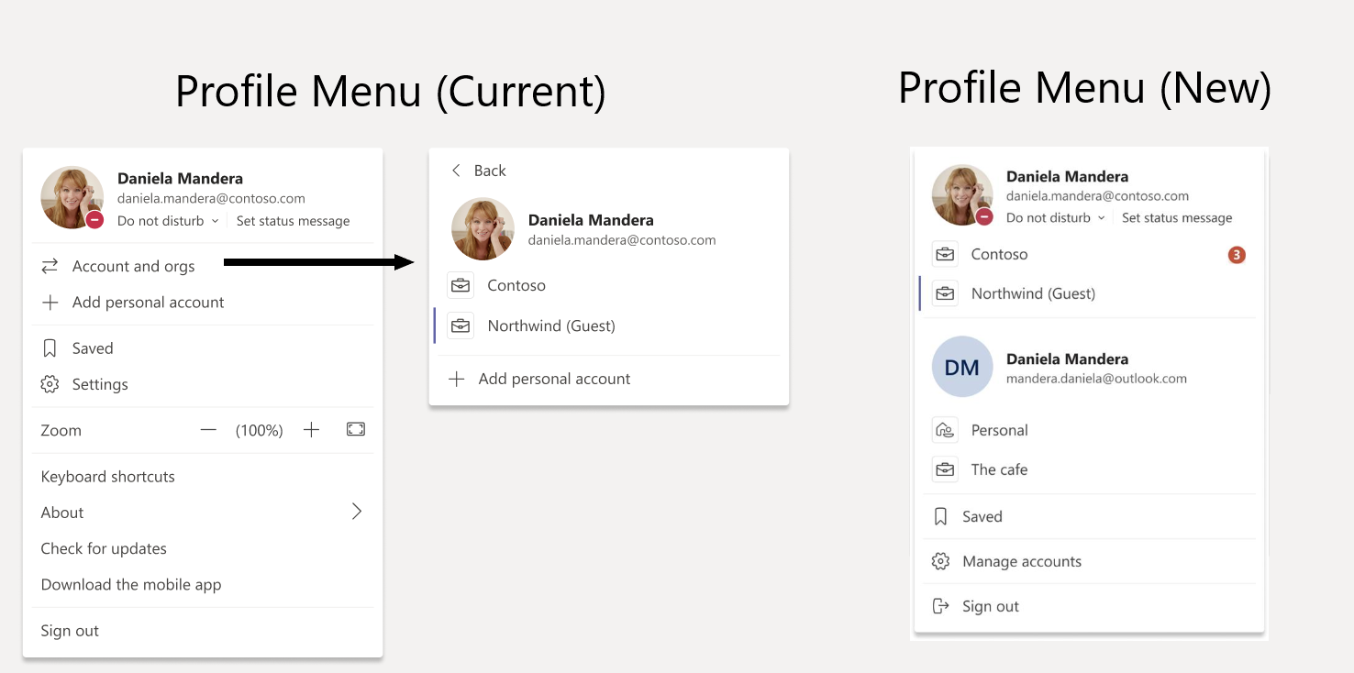
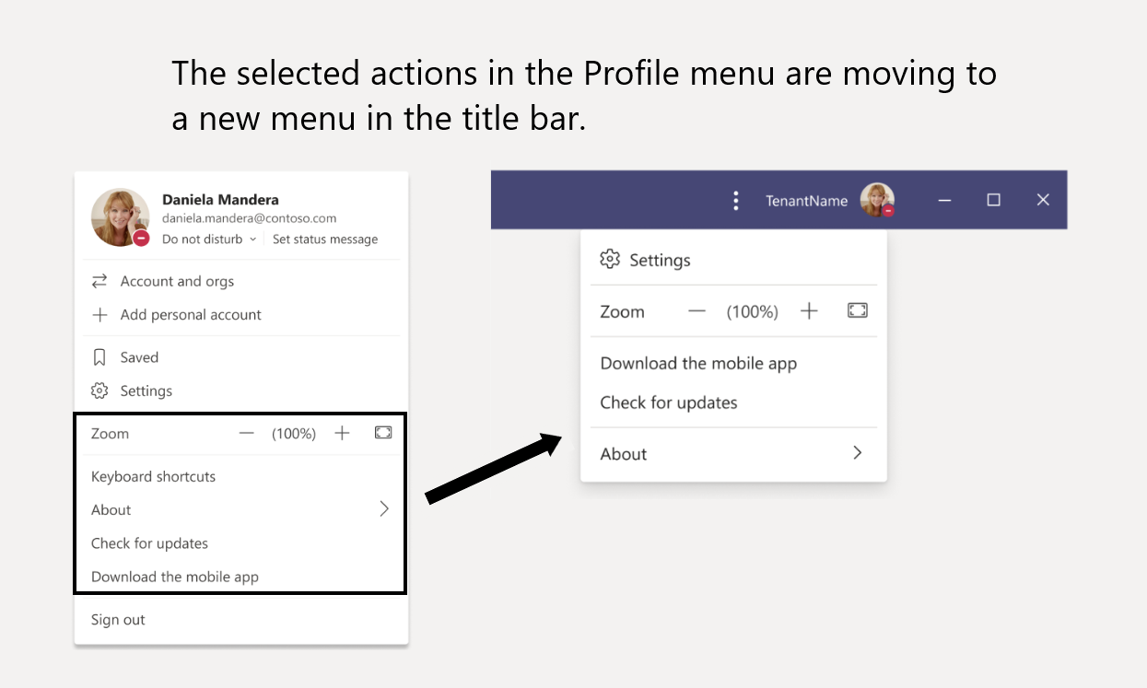
Profile menu update, relocating profile menu links to a new menu in the title bar

Slide 23
Was ist neu in Teams
Option to create all meetings online in Outlook for Windows (Januar)
Profile menu update, relocating profile menu links to a new menu in the title bar (Januar)
Revised In-meeting Share Experience (März)
Teams desktop app for Mac: Include computer sound in a meeting (Februar)
Change in display of hierarchical sensitivity labels (März)
Introducing history menu in Microsoft Teams (Februar)
Use an iPad to present in a live event (→ Februar)

Slide 24
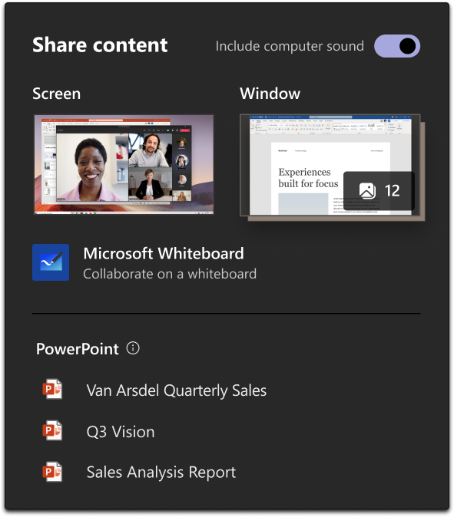
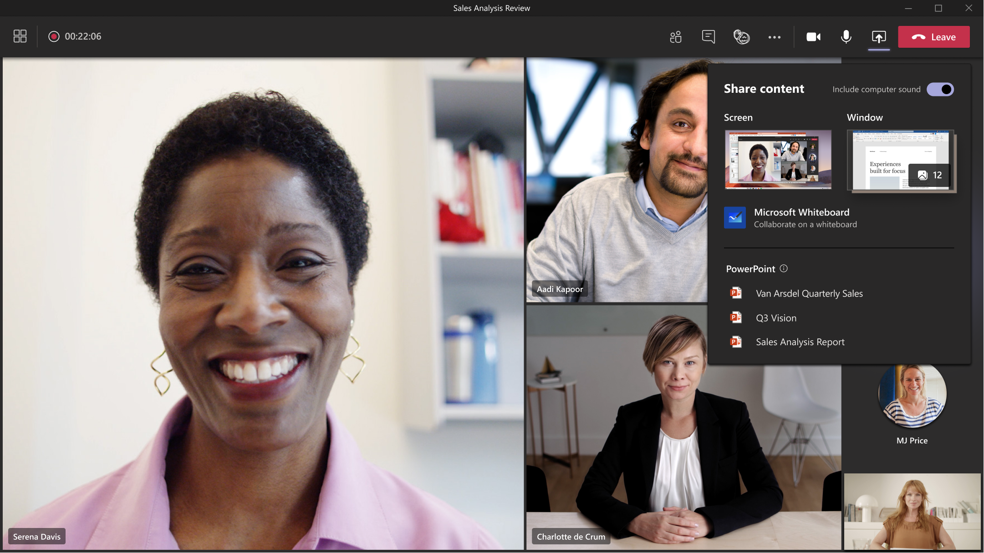
Revised In-meeting Share Experience
Notes:
https://www.microsoft.com/en-us/microsoft-365/roadmap?filters=&searchterms=70560

Slide 25
Was ist neu in Teams
Option to create all meetings online in Outlook for Windows (Januar)
Profile menu update, relocating profile menu links to a new menu in the title bar (Januar)
Revised In-meeting Share Experience (März)
Teams desktop app for Mac: Include computer sound in a meeting (Februar)
Change in display of hierarchical sensitivity labels (März)
Introducing history menu in Microsoft Teams (Februar)
Use an iPad to present in a live event (→ Februar)

Slide 26
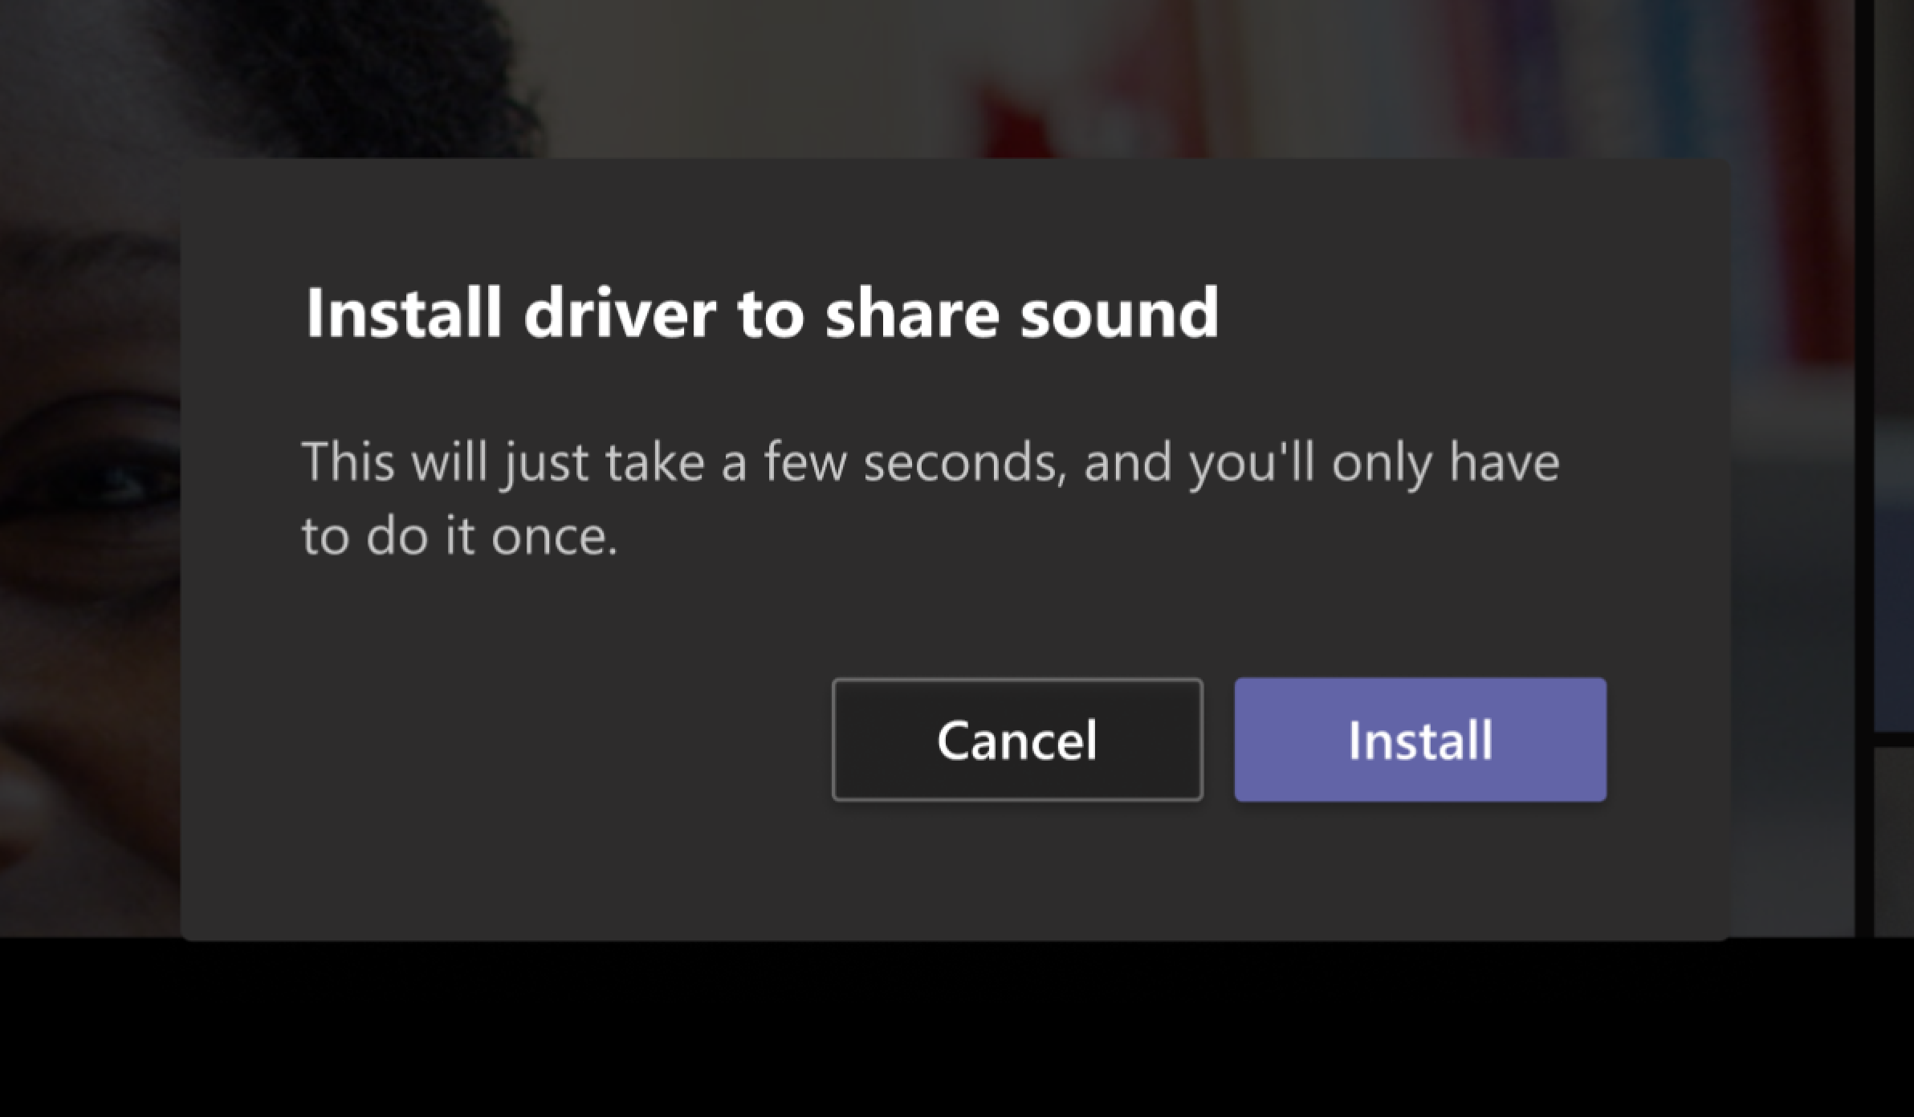
Teams desktop app for Mac: Include computer sound in a meeting
Notes:
https://www.microsoft.com/microsoft-365/roadmap?rtc=1%26filters=&searchterms=67168
This feature requires a one-time installation of an audio driver. Users will be prompted to install the audio driver when they select Include computer sound from the Share content tray in a meeting.

Slide 27
Was ist neu in Teams
Option to create all meetings online in Outlook for Windows (Januar)
Profile menu update, relocating profile menu links to a new menu in the title bar (Januar)
Revised In-meeting Share Experience (März)
Teams desktop app for Mac: Include computer sound in a meeting (Februar)
Change in display of hierarchical sensitivity labels (März)
Introducing history menu in Microsoft Teams (Februar)
Use an iPad to present in a live event (→ Februar)

Slide 28
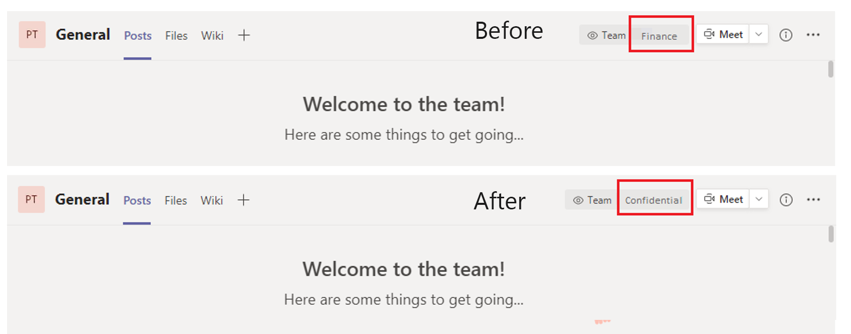
Change in display of hierarchical sensitivity labels
Notes:
Currently, the Teams channel header displays the child label for hierarchical sensitivity labels (e.g., Confidential > Finance) in the channel header. We will now display the parent label rather than the child label. In this example, Confidential > Finance, we will display Confidential in the channel header rather than Finance.

Slide 29
Was ist neu in Teams
Option to create all meetings online in Outlook for Windows (Januar)
Profile menu update, relocating profile menu links to a new menu in the title bar (Januar)
Revised In-meeting Share Experience (März)
Teams desktop app for Mac: Include computer sound in a meeting (Februar)
Change in display of hierarchical sensitivity labels (März)
Introducing history menu in Microsoft Teams (Februar)
Use an iPad to present in a live event (→ Februar)

Slide 30
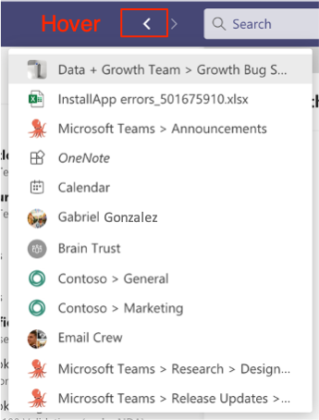
Introducing history menu in Microsoft Teams
Notes:
https://www.microsoft.com/microsoft-365/roadmap?filters=&searchterms=70545

Slide 31
Was ist neu in Teams
Option to create all meetings online in Outlook for Windows (Januar)
Profile menu update, relocating profile menu links to a new menu in the title bar (Januar)
Revised In-meeting Share Experience (März)
Teams desktop app for Mac: Include computer sound in a meeting (Februar)
Change in display of hierarchical sensitivity labels (März)
Introducing history menu in Microsoft Teams (Februar)
Use an iPad to present in a live event (→ Februar)

Slide 32
Was ist neu in Teams
Microsoft Teams introduces meeting recap in the calendar event details tab (Februar)
New Teams meeting lobby setting - only invited users join directly (Februar)
Start Meet Now from Outlook desktop client for Windows (Februar)
Add a shared calendar to a Teams channel (→ Januar)
Introducing Approvals in Microsoft Teams (Januar)

Slide 33
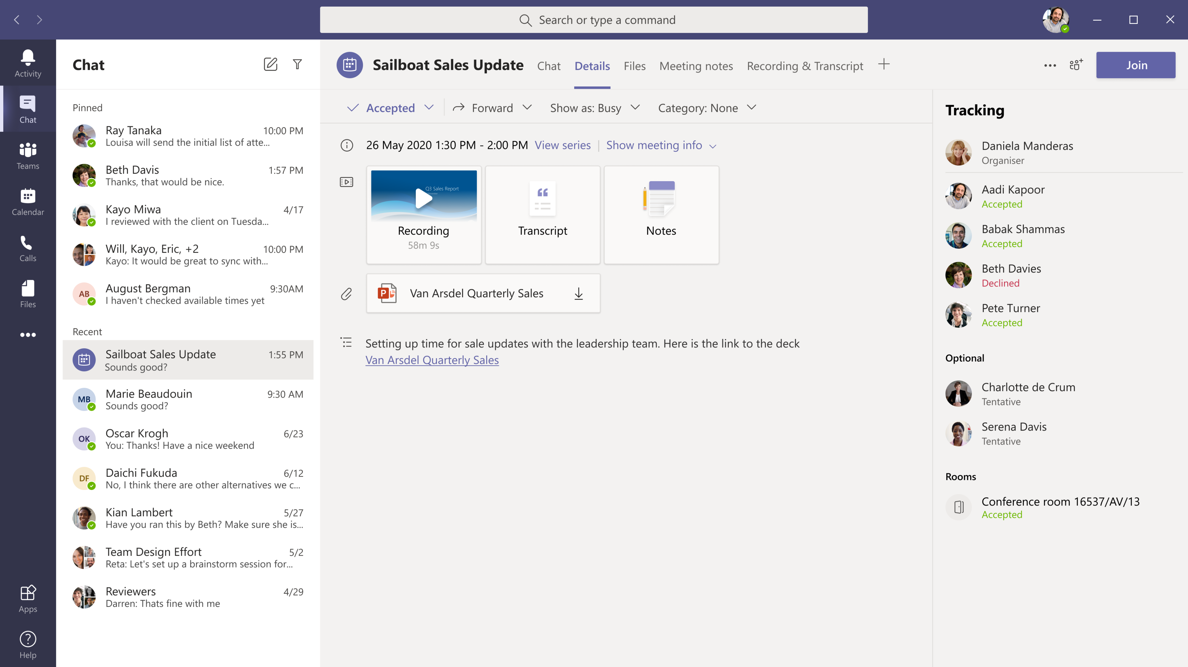
Microsoft Teams introduces meeting recap in the calendar event details tab
Notes:
https://www.microsoft.com/microsoft-365/roadmap?filters=&searchterms=68729

Slide 34
Was ist neu in Teams
Microsoft Teams introduces meeting recap in the calendar event details tab (Februar)
New Teams meeting lobby setting - only invited users join directly (Februar)
Start Meet Now from Outlook desktop client for Windows (Februar)
Add a shared calendar to a Teams channel (→ Januar)
Introducing Approvals in Microsoft Teams (Januar)

Slide 35
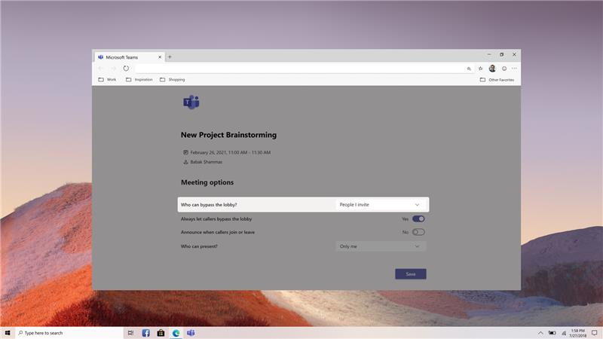
New Teams meeting lobby setting - only invited users join directly
Notes:
https://www.microsoft.com/microsoft-365/roadmap?ms.url=m365comroadmap&rtc=1&filters=&searchterms=68730

Slide 36
Was ist neu in Teams
Microsoft Teams introduces meeting recap in the calendar event details tab (Februar)
New Teams meeting lobby setting - only invited users join directly (Februar)
Start Meet Now from Outlook desktop client for Windows (Februar)
Add a shared calendar to a Teams channel (→ Januar)
Introducing Approvals in Microsoft Teams (Januar)

Slide 37
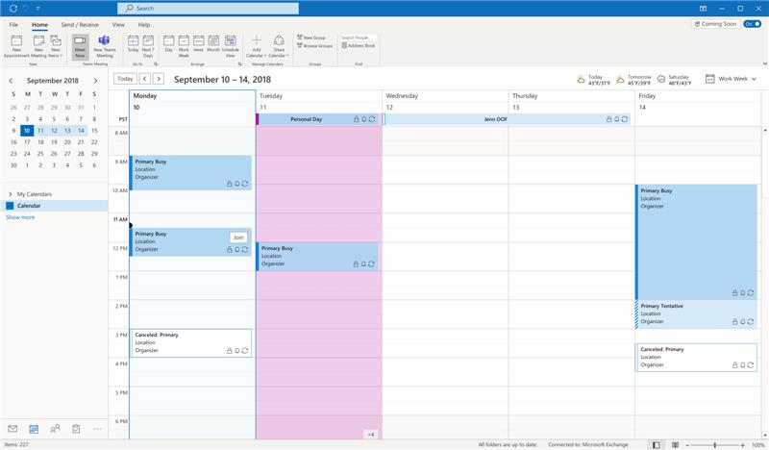
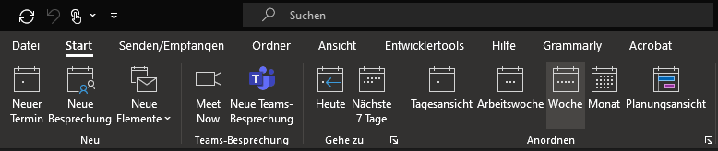
Start Meet Now from Outlook desktop client for Windows
Notes:
https://www.microsoft.com/microsoft-365/roadmap?filters=&searchterms=68838

Slide 38
Was ist neu in Teams
Microsoft Teams introduces meeting recap in the calendar event details tab (Februar)
New Teams meeting lobby setting - only invited users join directly (Februar)
Start Meet Now from Outlook desktop client for Windows (Februar)
Add a shared calendar to a Teams channel (→ Januar)
Introducing Approvals in Microsoft Teams (Januar)

Slide 39
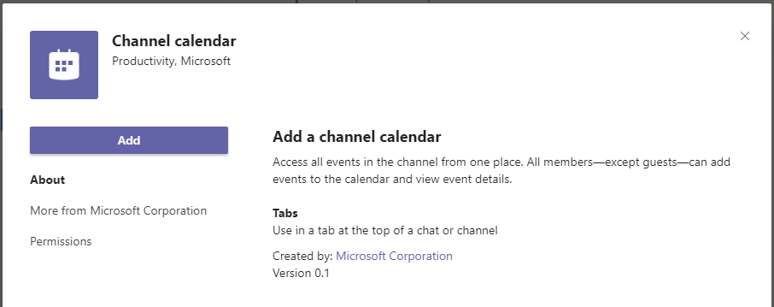
Add a shared calendar to a Teams channel
Notes:
https://www.microsoft.com/microsoft-365/roadmap?filters=&searchterms=68910

Slide 40
Was ist neu in Teams
Microsoft Teams introduces meeting recap in the calendar event details tab (Februar)
New Teams meeting lobby setting - only invited users join directly (Februar)
Start Meet Now from Outlook desktop client for Windows (Februar)
Add a shared calendar to a Teams channel (→ Januar)
Introducing Approvals in Microsoft Teams (Januar)

Slide 41
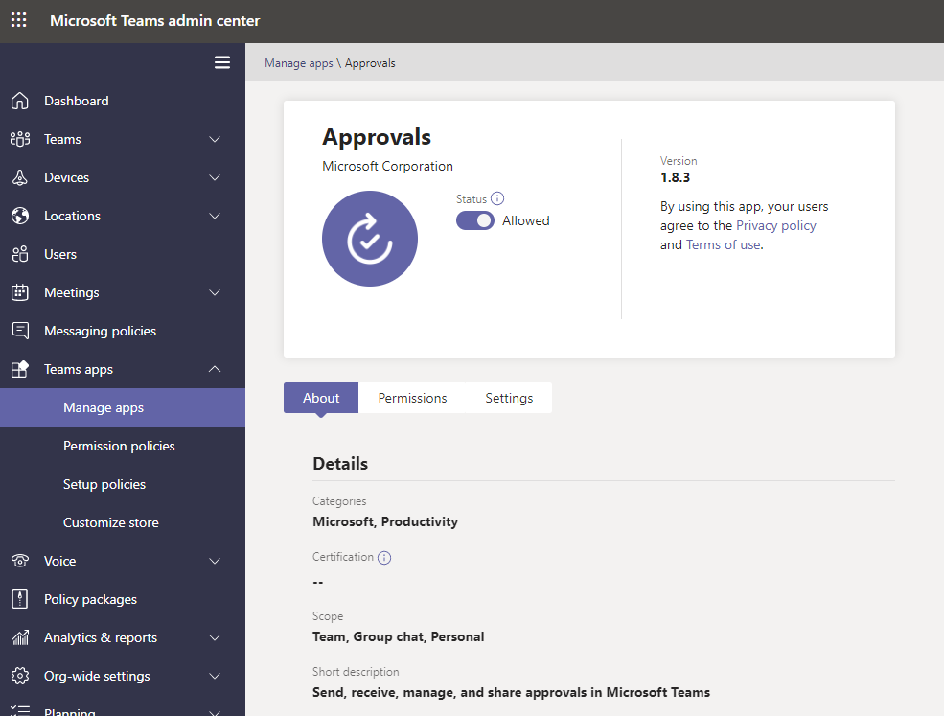
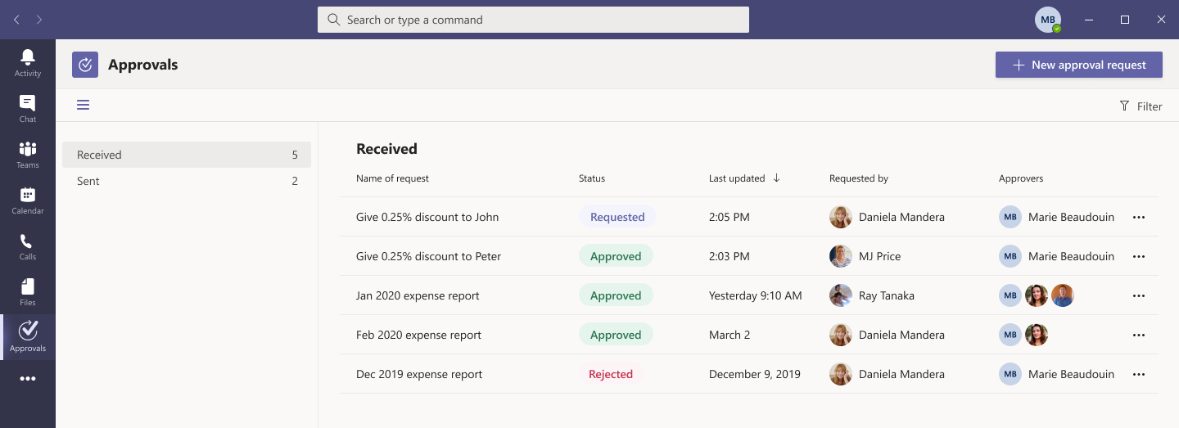
Introducing Approvals in Microsoft Teams
Notes:
https://www.microsoft.com/microsoft-365/roadmap?filters=&searchterms=68724

Slide 42
Was ist neu in Teams – für Administratoren
Configuration Change in Guest access for Microsoft Teams (8. Februar)
Task publishing feature for frontline organizations now available in Microsoft Teams (Januar)
Vorbereitung: https://docs.microsoft.com/microsoftteams/set-up-your-team-hierarchy
Skype for Business Online Connector retirement (Februar)
Nutzung bis 31. Juli 2021 unterstützt
Microsoft Teams connector apps webhook URL security improvement (Januar)
Notes:
https://www.microsoft.com/microsoft-365/roadmap?filters=&searchterms=59719

Slide 43
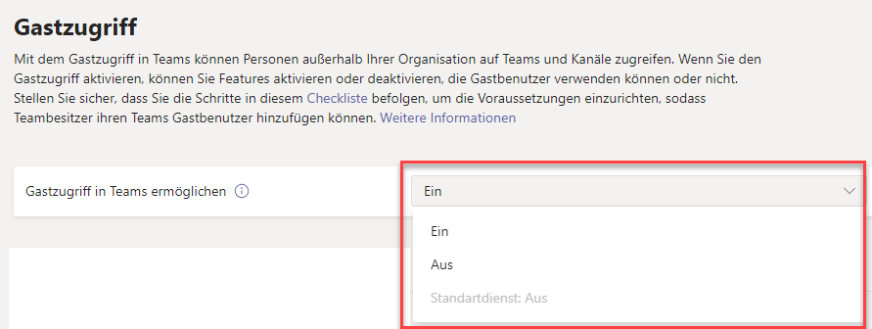
Configuration Change in Guest access for Microsoft Teams

Slide 44
Was ist neu in Teams – für Administratoren
Configuration Change in Guest access for Microsoft Teams (8. Februar)
Task publishing feature for frontline organizations now available in Microsoft Teams (Januar)
Vorbereitung: https://docs.microsoft.com/microsoftteams/set-up-your-team-hierarchy
Skype for Business Online Connector retirement (Februar)
Nutzung bis 31. Juli 2021 unterstützt
Microsoft Teams connector apps webhook URL security improvement (Januar)
Notes:
https://www.microsoft.com/microsoft-365/roadmap?filters=&searchterms=59719

Slide 45
Was ist neu in Teams – für Administratoren
Configuration Change in Guest access for Microsoft Teams (8. Februar)
Task publishing feature for frontline organizations now available in Microsoft Teams (Januar)
Vorbereitung: https://docs.microsoft.com/microsoftteams/set-up-your-team-hierarchy
Skype for Business Online Connector retirement (Februar)
Nutzung bis 31. Juli 2021 unterstützt
Microsoft Teams connector apps webhook URL security improvement (Januar)
Notes:
https://www.microsoft.com/microsoft-365/roadmap?filters=&searchterms=59719

Slide 46
Was ist neu in Teams – für Administratoren
Configuration Change in Guest access for Microsoft Teams (8. Februar)
Task publishing feature for frontline organizations now available in Microsoft Teams (Januar)
Vorbereitung: https://docs.microsoft.com/microsoftteams/set-up-your-team-hierarchy
Skype for Business Online Connector retirement (Februar)
Nutzung bis 31. Juli 2021 unterstützt
Microsoft Teams connector apps webhook URL security improvement (Januar)
Notes:
https://www.microsoft.com/microsoft-365/roadmap?filters=&searchterms=59719

Slide 47
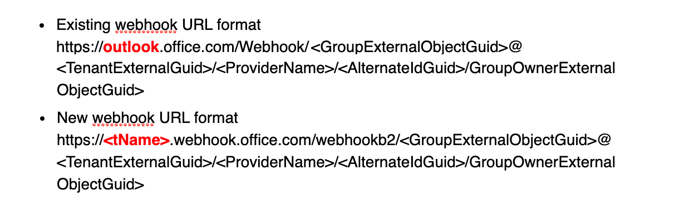
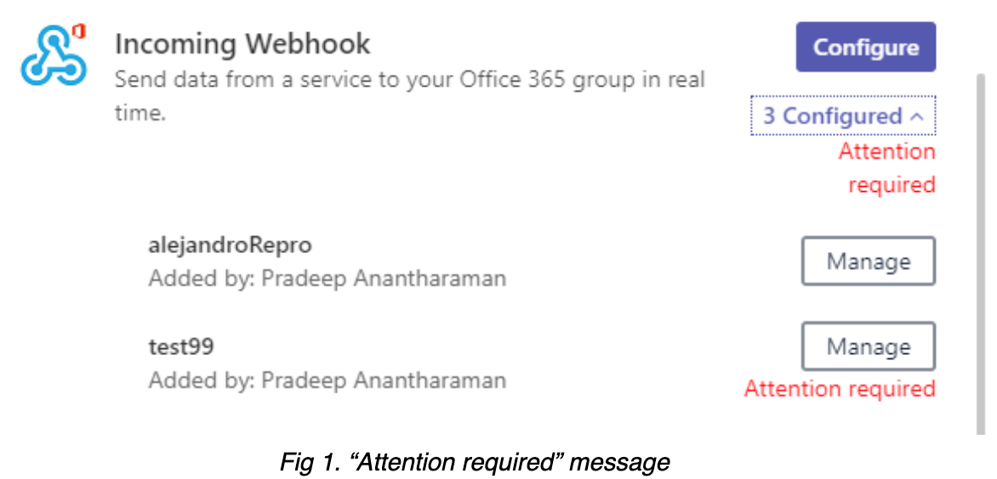
Microsoft Teams connector apps webhook URL security improvement

Slide 48
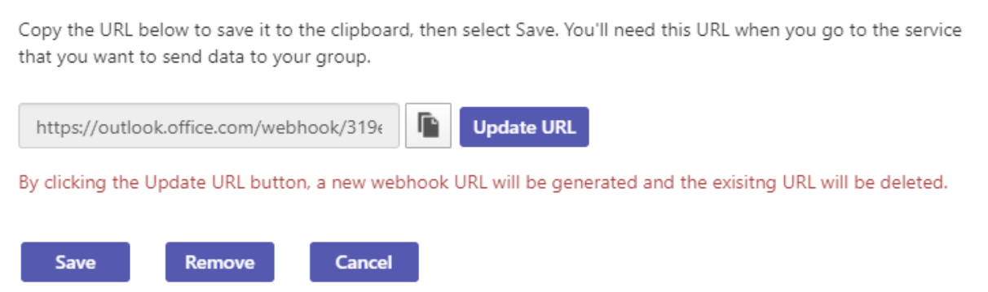
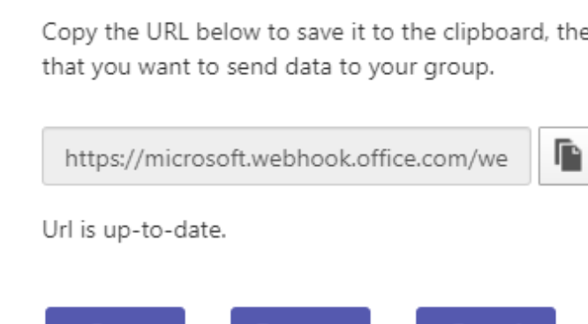
Microsoft Teams connector apps webhook URL security improvement

Slide 49
Was ist neu in Teams – für Administratoren
User feedback improvements (März)
Manage feedback policies in Microsoft Teams
Teams auto attendant Island mode transfer behavior change
Skype for Business Online endet am 31. Juli 2021
Extending the temporary limit increase for live events
Bis zu 20.000 Teilnehmer, 50 gleichzeitige Events im Tenant, ja 16h Dauer
Bis zum 30. Juni 2021
Block Download Permissions for Teams Meeting Recordings on OneDrive and SharePoint (April)

Slide 50
User feedback improvements

Slide 51
Was ist neu in Teams – für Administratoren
User feedback improvements (März)
Manage feedback policies in Microsoft Teams
Teams auto attendant Island mode transfer behavior change
Skype for Business Online endet am 31. Juli 2021
Extending the temporary limit increase for live events
Bis zu 20.000 Teilnehmer, 50 gleichzeitige Events im Tenant, ja 16h Dauer
Bis zum 30. Juni 2021
Block Download Permissions for Teams Meeting Recordings on OneDrive and SharePoint (April)
Notes:
Teams Auto Attendant
Current default experience: when PSTN calls are transferred to users configured with the coexistence mode of Islands, the calls are routed to the user’s Skype for Business client.
New default experience: when PSTN calls are transferred to users configured with the coexistence mode of Islands, the calls will be routed to the user’s Teams client.

Slide 52
Was ist neu in Teams – für Administratoren
User feedback improvements (März)
Manage feedback policies in Microsoft Teams
Teams auto attendant Island mode transfer behavior change
Skype for Business Online endet am 31. Juli 2021
Extending the temporary limit increase for live events
Bis zu 20.000 Teilnehmer, 50 gleichzeitige Events im Tenant, ja 16h Dauer
Bis zum 30. Juni 2021
Block Download Permissions for Teams Meeting Recordings on OneDrive and SharePoint (April)

Slide 53
Was ist neu in Teams – für Administratoren
User feedback improvements (März)
Manage feedback policies in Microsoft Teams
Teams auto attendant Island mode transfer behavior change
Skype for Business Online endet am 31. Juli 2021
Extending the temporary limit increase for live events
Bis zu 20.000 Teilnehmer, 50 gleichzeitige Events im Tenant, ja 16h Dauer
Bis zum 30. Juni 2021
Block Download Permissions for Teams Meeting Recordings on OneDrive and SharePoint (April)

Slide 54
Was ist neu in Teams – für Administratoren
Branch office survivability for Teams customers that have configured voice resiliency (Januar)
AudioCodes, Oracle, Ribbon Communications und TE-SYSTEMS

Slide 55
Was ist neu in Teams – Der Blog
What’s New in Microsoft Teams | January 2021
What‘s New in Microsoft Teams | December 2020
Microsoft Teams Blog

Slide 56
Pause ☺
→ Gleich geht es weiter

Slide 57
Agenda
18:00 - 18:15 | Landing Zone
18:15 - 19:15 | Talk 1 - Microsoft Teams Lifecycle Management with Power Suite Michael Plettner (@plemich)
19:15 - 19:30 | Pause
19:30 - 19:50 | Thomas Stensitzki Microsoft Teams Neuigkeiten
20:00 - 20:45 | Talk 2 - Microsoft Teams und Data Loss Prevention Torben Ritter (@TobiRitter)
20:45 - ? | Fragen und Antworten rund um Teams Organisatorisches
Dieses Meeting wird aufgezeichnet und im Community Tenant Team für User Group Mitglieder bereitgestellt. This meeting will be recorded and published in the User Group Community Tenant.

Slide 58
Microsoft Teams und Data Loss Prevention
Torben Ritter @TobiRitter

Slide 59
Organisatorisches

Slide 60
Organisatorisches
Microsoft Community Tenant für User Groups
Microsoft 365 Gast-Konten für User Group Mitglieder
Anmeldung: https://go.granikos.eu/TeamsUGForm
SWAG
Community Sticker https://go.granikos.eu/CommunitySticker
Merchandise-St
Microsoft Teams User Group Website
https://TeamsUserGroup.Berlin
Unterstützung gesucht ☺ (insbesondere zum Thema WordPress)

Slide 61
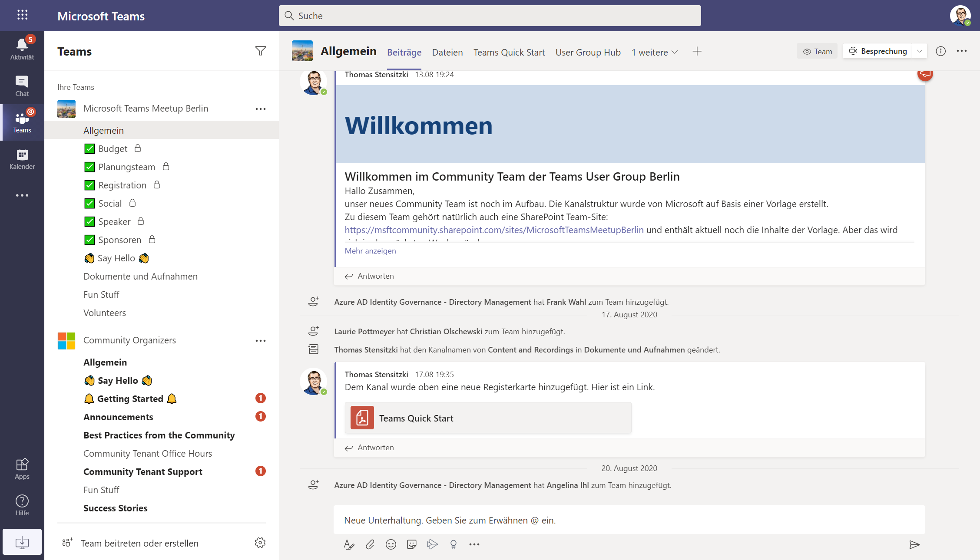

Slide 62
Vielen Dank für eure Teilnahme!
Das nächste Meetup:
→ 15. April 2021
https://go.granikos.eu/TeamsMeetupBerlin
Spread the Word!
#TeamsUGBerlin
Aufzeichnungen unserer Meetups sind im Community Team verfügbar.

Slide 63
Offene Diskussion

